Slide 1
IBQC Global Construction Dispute Resolution Conference
How to improve affordability and accessibility to construction dispute resolution – a global thought leadership conference
Session Two, September 13, 2023, 5 p.m. GMT

Slide 2
Welcome & Housekeeping
This webinar will be recorded and will be posted on the IBQC website along with the presentation slides after the event.
Time permitting, we will address questions and discussion at the end of the presentations
If you have a question, please use the chat function at any time to submit your question.

Slide 3
Introducing Her Honour Justice Gloria A. Namonde
High Court Judge, Commercial Division, Malawi
&
Her Honour Justice Gladys A. Gondwe
High Court Judge, Malawi

Slide 4
AN OVERVIEW OF CONSTRUCTION DISPUTES RESOLUTION IN MALAWI- BEST PRACTICES FOR COST REDUCTION

Slide 5
OUTLINE
Introduction
Infrastructure development
Construction disputes
The legal framework
Conclusion

Slide 6
INTRODUCTION
Being a developing country and a small economy, Malawi has its own aspirations to achieve especially in terms of infrastructure development. This is evident when one looks at the Malawi 2063 Agenda, ( hereafter the 2063 Agenda). The Malawi 2063 agenda is an official document and roadmap by the Malawi Government that details how as a country, we intend to become a self-reliant nation with a minimum per capita income of 4000 USD. This comes from our desire as Malawians ‘to be an inclusively wealthy and self-reliant industrialized upper-middle income country by the year 2063, we want to fund our development needs by ourselves.

Slide 7
THE ROADMAP TO DEVELOPMENT
THE MALAWI 2063 AGENDA WHICH HAS 10 GOALS, 3 OF WHICH ARE RELEVANT TO THE DISCUSSION AT HAND:
vibrant knowledge-based economy with a robust competitive manufacturing industry that is driven by a productive and commercially vibrant agriculture and mining sector;
World-class urban centers and tourist hubs across the country with requisite socio-economic amenities for a high quality life;
Globally competitive economic infrastructure

Slide 8
INFRASTRUCTURE DEVELOPMENT
Presently, there are noticeable developments going on in Malawi from renovation or construction of
Roads, E.G. the M 1 road (the main road in Malawi connecting different regions and all districts in Malawi is currently being rehabilitated.
Renovation of railways,
Construction of secondary schools, teachers training schools, Court buildings, etc.

Slide 9
CONSTRUCTION DISPUTES
Construction being ‘a fertile source of disputes’, obviously Malawi is not an exception from construction disputes. Causes of such disputes include delays caused by a number of factors, payment, disagreements to modified or amended plans, and professional negligence. If not addressed or resolved, disputes can result in projects being delayed further or halted and this is not an option for Malawi as the economy is still young and struggling as already pointed out. As such each and every penny needs to be utilized for the benefit of the people.

Slide 10
THE LEGAL FRAMEWORK
THE CONSTITUTION
THE COURT’S ACT
THE NATIONAL CONSTRUCTION INDUSTRY ACT
THE ARBITRATION ACT
THE COURT ( HIGH COURT) CIVIL PROCEDURE RULES

Slide 11
THE CONSTITUTION
The Constitution of the Republic of Malawi gives the High Court unlimited original jurisdiction. Thus, the High Court in Malawi can virtually preside over any matter under the sun, construction disputes being one of them. Section 108 of the Republican Constitution.
The Court’s Act has created different divisions within the high Court with different specialties.

Slide 12
THE COURTS ( HIGH COURT) (CIVIL PROCEDURE) RULES 2017
Once parties have subjected themselves to the jurisdiction of the Court, The Courts (High Court)(Civil Procedure) Rules, (hereafter called the CPR). The CPR has given a judge wide discretionary powers in how a case before him or her is to be resolved whilst keeping in mind the overriding objectives of the CPR, which include:
ensuring that parties are on an equal footing;
Saving expenses;
Dealing with a proceeding in ways that are proportionate to the –
the amount of money involved;
ii. importance of the proceeding; and
iii. complexity of the issues
Ensuring that a proceeding is dealt with expeditiously and fairly;

Slide 13
ACTIVE CASE MANAGEMENT AS A MEANS TO COST REDUCTION
encouraging the parties to cooperate with each other in the conduct of the proceeding;
identifying the issues for resolution at an early stage;
deciding promptly which issues need full investigation and trial and accordingly disposing summarily of the others;
deciding the order in which issues are to be resolved;
encouraging the parties to use an alternative dispute resolution procedure if the Court considers it appropriate, and facilitating the use of such procedure;

Slide 14
ACTIVE CASE MANAGEMENT, CONT’D
assisting the parties to settle the whole or part of the proceeding;
fixing timetables or otherwise controlling the progress of the proceeding;
considering whether the likely benefits of taking a particular step justify the cost of taking it;
dealing with as many aspects of the proceeding as the Court can on the same occasion;
making use of technology; and
giving directions to ensure that the trial of a proceeding continues quickly and efficiently

Slide 15
MANDATORY MEDIATION
ORDER 13 OF THE CPR
The advantages are that if a matter gets resolved at mediation, the parties will go back in a conciliatory mood, relationship is not damaged, costs are reduced and time factor is also addressed
in conducting a mediation session under this Order―
the parties shall strive to reduce costs and delay in litigation, and facilitate the early and fair resolution of disputes; and
the Judge shall facilitate communication between or among the parties to the dispute in order to assist them in reaching a mutually acceptable resolution.

Slide 16
MANDATORY MEDIATION CONT’D
This is itself is a sure way of reducing costs in construction disputes. However, it has been noticed a number of times that other lawyers would not want a matter to end at mediation and encourage their clients not to be agreeable.
Mostly this is done for selfish reasons, as it means that if a matter is to go for trial, the lawyer will get paid more than if ends at mediation.
Thus whereas the process itself would be very cheap, it is costly for the main reason that the parties will have to pay their legal counsel for coming with them to Court as well as for preparing the mediation itself. Sight should not be lost to the fact that this mediation is Court driven and is a step within the proceedings before Court.

Slide 17
INJUNCTIONS
Some parties either between main contractor and sub-contractor or between the employer and contractor have rushed to Court to get an injunction. Mostly they would be coming to Court to seek an injunction ex parte or without notice to restrain another party from acting or proceeding to act in a particular way.
Performance Security Guarantee and Advance Payment Guarantee

Slide 18
INJUNCTIONS
In all these instances, costs were incurred. However, through Court processes, it is obvious that more costs would have been incurred but for the Court’s intervention through the CPR. Another notable fact is that all the matters were brought before Court as matters of extreme urgency which is indicative of the fact that the parties were in panic mode at the time.
In turn, this is a sign that the parties do realise that a lot is at stake. More often than not, the parties would have tried to resolve the matter between themselves but that their discussions would not have been fruitful.

Slide 19
ARBITRATION AVENUE
Arbitration of disputes is mainly guided by the Arbitration Act.
Section 6(1) of the Arbitration Act
The National Construction Industry Act
Arbitration Rules

Slide 20
CONCLUSION
From the case statistics ( which I have not confirmed, but it is obvious that there are not much construction disputes in the Courts), the cause of disputes in all the cases was in relation to the couching of key clauses within the contract. This is suggestive of the fact that where key clauses are clearly stipulated and fair, it automatically reduces disputes and in turn reduces costs in construction disputes.
It cannot be denied that the COVID-19 pandemic was one of the contributory factors to delays in construction projects that saw employers or main contractors claiming Advance Payment Guarantee or/and Performance Security Guarantee. This goes to how clauses are to be couched in case of eventualities like the COVID-19 pandemic where the whole world was brought to a halt. Otherwise, the law is comprehensive enough and it only needs to be fully utilized.

Slide 21
Presented by Justices Namonde & Gondwe
High Court of Malawi, Commercial Division
The views expressed in this paper are of the writers
only and are not the views of any other body.

Slide 22
Introducing Tsigereda Lovegrove
Lovegrove and Cotton Construction and Planning Lawyers Australia, Construction and planning lawyer

Slide 23
The Development of Contextualised Front End Mediation Mechanisms to Facilitate More Cost-effective Access to Construction Dispute Resolution in the Horn of Africa

Slide 24
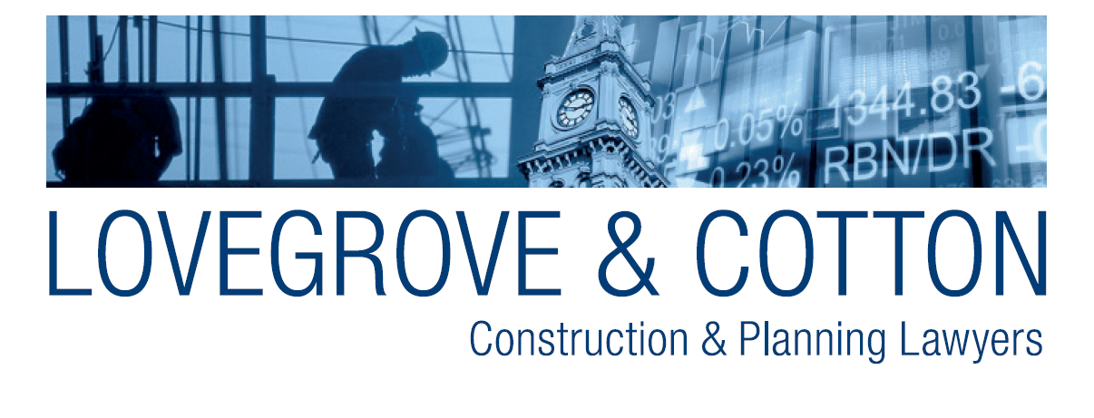
WHAT IS MEDIATION?
Mediation is a facilitative process in which parties in dispute come together to discuss and reach an outcome or resolve their disputes with the assistance of an impartial third party (a mediator).
The role of the mediator is to help the parties negotiate an agreed resolution of their dispute.
Unlike adjudicators mediators cannot impose judgment or make any decisions that are binding on the parties, instead, they apply their skills to assist the parties negotiate an agreed outcome without an outcome being forced upon them by a court or tribunal decision maker.

Slide 25
COMPULSORY MEDIATION
Compulsory mediation is critical to construction dispute resolution in an emerging economy.
At this conference you will hear that the cost of construction dispute resolution is very, very high everywhere.
Even in developed economies consumers find it very challenging to fund the cost of adversarial dispute resolution.
In emerging economies, the cost imposition is both prohibitive and unsustainable as in some emerging economies poverty is widespread and the majority of the population survive on a subsistence economy basis.
They simply cannot afford to spend their very finite financial resources on construction dispute resolution and as consumers they are incredibly vulnerable and in reality, are denied access to conventional judicial machinery.

Slide 26
THE MEDIATION IMPERATIVE
It follows that adversarial dispute resolution that is part of the DNA of traditional adversarial dispute resolution is simply not compatible for either the Horn of Africa or many emerging economies.
A contexturised best practice approach that is suitable for the ‘boots on the ground’ reality of emerging economies is mandatory front-end mediation.
The state can afford to license and accredit trained mediators and to make them accessible to disputants.

Slide 27
THE MEDIATION IMPERATIVE
But unlike some western jurisdictions like Victoria where the state underwrites the cost of the mediation apparatus in many African countries the state will not be able to underwrite that function.
It follows that the disputants will jointly remunerate the mediator and as most building disputes ultimately settle at mediation, mediation will occur before legal proceedings can be issued in a court of law or a tribunal.
Compulsory conciliation as a prerequisite to litigation is compulsory by law in the Australian state of Victoria.

Slide 28
A BEST PRACTICE MODEL MEDIATOR ACCREDITATION SYSTEM
Mediator Standards Board
State Register
Approval Standards
Practice Standards
Recognised Mediator Accreditation Bodies
Accreditation
Complaints
Training
Assessment

Slide 29
Presented by Tsigereda Lovegrove
Lawyer and Manager at Lovegrove & Cotton - Construction & Planning lawyers Australia
Past Ethiopian Consulate Attaché in Victoria
September 2023

Slide 30
Introducing Rachael Keay Kummer
Lovegrove and Cotton Construction and Planning Lawyers Australia, Construction and planning lawyer

Slide 31
The Pros and Cons of Arbitration in the United States

Slide 32
Presenter
Raechel Kummer focuses her practice on complex commercial and class action litigation and high-stakes governmental and internal investigations. Raechel has argued as lead counsel in the US Court of Appeals for the Third, Seventh, Ninth, Eleventh, and DC Circuits, and served as lead counsel in bid protest litigation in the US Court of Federal Claims and in multiple jury trials.
Raechel represents technology and mobility companies, retail and ecommerce companies, energy companies, and companies in the construction industry in high-exposure lawsuits involving contract and fraud claims, regulatory challenges, privacy claims, high-value tax issues, bankruptcy, copyright infringement, and white collar matters.
Raechel Keay Kummer
Washington, D.C.
+1.202.373.6235
raechel.kummer@morganlewis.com
2

Slide 33
U.S. Federal Law Encourages Arbitration
The U.S. Federal Arbitration Act (“FAA”) reflects a “liberal federal policy favoring arbitration agreements.” Moses H. Cone Mem’l Hosp. v. Mercury Constr. Corp., 460 U.S. 1, 24, 103 S. Ct. 927, 941 (1983)).
The FAA created substantive federal law that is applicable in both federal and state courts.
The FAA preempts any contrary state law in the U.S.
Section 2 of the FAA provides that arbitration agreements governed by the FAA “shall be valid, irrevocable, and enforceable, save upon such grounds as exist at law or in equity for the revocation of any contract.” 9 U.S.C. § 2.
Under the FAA, any doubts concerning the scope of arbitrable issues must be resolved in favor of arbitration.

Slide 34
Arbitration Is Popular In The U.S.
There are a range of arbitration providers in the US, include the American Arbitration Association (“AAA”), JAMS, and ADR Services, Inc.
AAA resolved more than 10,000 cases and nearly $15 million in claims in 2022 alone. See American Arbitration Association, 2022 AAA-ICDR B2B Case Statistics (2022).

Slide 35
Timeliness
Arbitrations tend to be much faster than litigation.
AAA estimates that, on average, U.S. district court cases took more than one year longer to resolve than cases decided by arbitration.
shortened discovery times
simplified procedures
See American Arbitration Association, Measuring the Costs of Delays in Dispute Resolution, https://go.adr.org/impactsofdelay.html.

Slide 36
Arbitration Costs
Arbitration is frequently a cost effective method of dispute resolution.
Arbitration proceedings are often shorter and less complicated than litigation in court.
Discovery is typically limited.
Motions practice is typically limited.
Parties may incur fewer attorneys' fees.
Parties can customize an arbitration with the arbitrator to suit their specific budget and needs.
Binding arbitration likely avoids any appellate process.

Slide 37
However, Arbitration Costs Are Rising
Arbitration is not always cheaper than litigation.
Particularly in complex commercial cases, arbitration providers may charge significant administrative fees.
The parties are responsible for the arbitrator’s hourly rate, and arbitrator’s fees may range from about $300 per hour to upwards of $1,300 an hour.
Frequently, parties elect to proceed before a single arbitrator, but in other instances, parties proceed before a three-arbitrator panel.
Depending on the type of dispute, arbitration can involve numerous depositions, including third party depositions, interrogatories, significant document productions, motions to dismiss and motions for summary judgment, and a potentially lengthy hearing.

Slide 38
Mass Arbitrations
There is a recent trend in the U.S. where plaintiffs who agreed to a class action waiver and mandatory arbitration clause are attempting to bring so-called mass arbitrations.
Plaintiffs have filed (or threatened to file) hundreds of individual claims simultaneously to attempt to leverage the potentially significant arbitration administration fees typically due for each individual arbitration at the outset of the matter to force settlement.
It is unclear how these mass arbitrations will develop.

Slide 39
Construction Specific Rules
Arbitration can provide enhanced benefits for the resolution of construction industry disputes in the U.S.
AAA and JAMS both offer specific rules and procedures for construction industry disputes.
AAA offers a range of procedures– regular track procedures, procedures for resolving disputes through document submissions, fast track procedures for claims less than $100,000, and procedures for large, complex disputes claiming greater than $1,000,000
JAMS offers both standard procedures and an expedited option for binding arbitratrion.
JAMS also offers a specific panel of Construction Project Neutrals who can provide non-binding mediation services to help resolve controversies that might arise from the design phase through the final certificate of occupancy and acceptance of the Project.
Procedures may include a preliminary management hearing, pre-hearing exchange of information, and a formal hearing prior to an arbritration award.

Slide 40
Construction Focused Arbitrators
AAA, for example, maintains a National Construction Panel, where the majority of the arbitrators “are actively engaged in the construction industry with attorney arbitrators generally devoting at least half of their practice to construction matters.”
https://www.adr.org/sites/default/files/ConstructionRules_Web_0.pdf

Slide 41
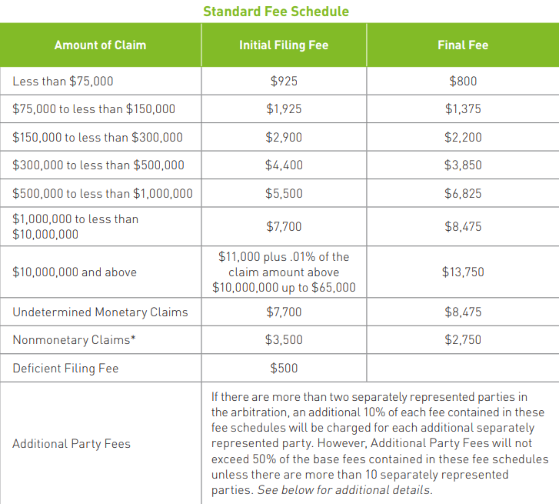
Arbitration Providers May Offer Fee Schedules Specifically for Construction Disputes
https://www.adr.org/sites/default/files/Construction_Arbitration_Fee_Schedule_0.pdf

Slide 42
Conclusion
Binding arbitration may provide an effective method to resolve construction industry disputes.
AAA and JAMS have developed construction specific rules and procedures that are publicly available for review online.

Slide 45
Introducing Zama Ngcobo
Senior South African Construction Lawyer with pan-African construction law practice and board member of the IBQC
&
Professor Alfred Omenya
Prof of University of Nairobi, CEO Eco Build Africa, & Adjuct Prof. University of Canberra

Slide 46
Challenges in Emerging Economies and How the IBQC Guidelines Serve as a Guide for Improving Construction Dispute Resolution in Africa and Other Emerging Regional Economies

Slide 47
Presented by Zama Ngcobo and Prof Alfred Omenya

Slide 48
Introducing Alejandro Espinosa-Wang
Senior Private Sector Specialist, World Bank and inaugural board member of the IBQC

Slide 49
Why Better Access to Justice in the Construction Dispute Resolution Sector is an Economic Imperative for Emerging Economies – an Economists’ Perspective
Alejandro Espinosa-Wang, Senior Private Sector Specialist, World Bank

Slide 50
A holistic building control System is key to ensure safety standards that protect the public while making the permitting process efficient, transparent and affordable
Building Control Holistic System
2. Consolidated Legislative Hierarchy
6. Effective Licensing and Probity Regime
8. Liability, Accountability & Indemnification Systems
7. Effective Product Assurance Frameworks
3. Risk-based Building Code & Building Classifications
1. Central Government Regulators ('CGR') and Administrative Bodies
5. Sustainable Funding for Building Regulation
4. A Robust Building Inspection Regime
9. Efficient Conflict Resolution Systems

Slide 51
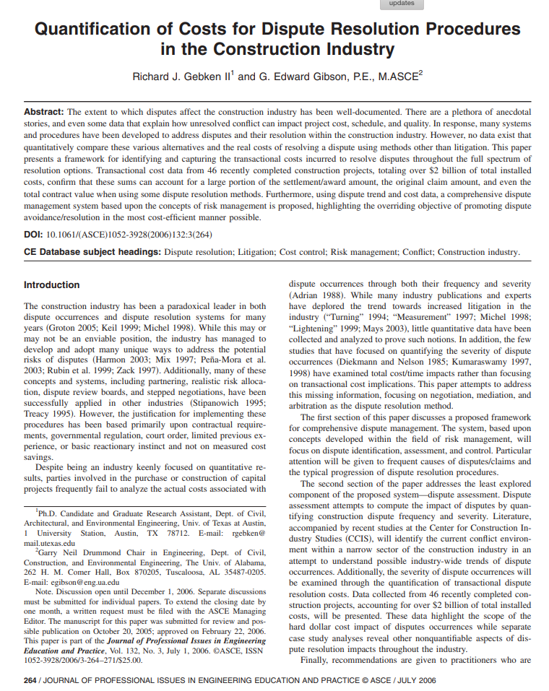
Litigation is likely more costly than mediation or other ADR methods and mediation and arbitration also tend to be most costly than negotiation
Costs for mediation ($1.2 million)/arbitration ($1.17 million)/ negotiation ($330,000).
The median dispute amount was smallest for negotiation ($250,000) and largest for arbitration ($1.8 million)
Smaller disputes had higher transactional costs (39% of claim value) compared to bigger disputes (17% of claim value).
Transactional costs represented 2% of the total contract value for projects with disputes.
Total transactional costs for construction dispute resolution in the US at $4-12 billion per year. If 5% of disputes go to litigation (an estimate cited), litigation's share of that could be $200 million - $600 million.
$5 billion spent annually on construction litigation. Adjusted for inflation since 1998, that equates to around $11 billion today.
Notes:
The mean transactional costs for mediation ($1.2 million) and arbitration ($1.17 million) were much higher than for negotiation ($330,000).
The median dispute amount was smallest for negotiation ($250,000) and largest for arbitration ($1.8 million), suggesting very large claims go to arbitration/litigation.
Smaller disputes had higher transactional costs (39% of claim value) compared to bigger disputes (17% of claim value).
This implies litigation and arbitration, typically used for larger claims, are proportionally cheaper than mediation or negotiation for small claims.
Transactional costs represented 2% of the total contract value for projects with disputes. For a $100 million construction contract that went to litigation, 2% would equal $2 million in transactional costs.
The paper estimates total transactional costs for construction dispute resolution in the US at $4-12 billion per year. If 5% of disputes go to litigation (an estimate cited), litigation's share of that could be $200 million - $600 million.
An expert cited estimated $5 billion spent annually on construction litigation. Adjusted for inflation since 1998, that equates to around $11 billion today.

Slide 52
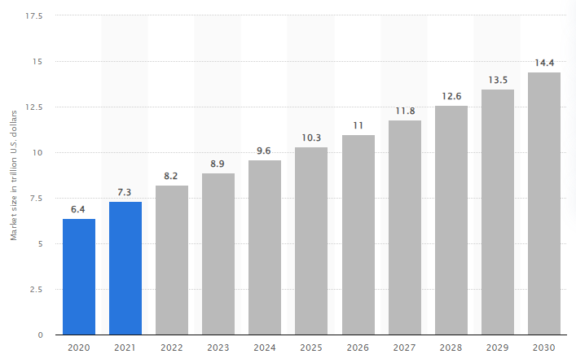
Construction is a major industry in most emerging economies, contributing significantly to GDP
Construction is a major GDP contributor in emerging economies . (6.3% - World Bank, 2020, 15% in China – ECB, 2018).
Lengthy disputes derail projects, causing economic ripples.
Unresolved disputes create uncertainty, reducing investment.
Multi-party disputes magnify costs when institutions are weak.
Effective dispute resolution enables essential infrastructure and real estate growth
Size of the global construction market from 2020 to 2021, with forecasts from 2022 to 2030(in trillion U.S. dollars)
8% of global econ.
Source: Statista 2023
Notes:
Construction is a major industry in most emerging economies, contributing significantly to GDP. (6.3% - World Bank, 2020, 15% in China – ECB, 2018).
Long, costly disputes can derail or delay construction projects, which has ripple effects across the economy in job losses, unfinished infrastructure, and reduced economic activity.
If disputes arise but aren't resolved quickly and fairly, it creates uncertainty and risk for construction firms and investors, reducing future investment and development.
Construction disputes often involve multiple parties - owners, contractors, subcontractors, suppliers, etc. Weak institutions multiply the economic costs as disputes drag on.
Emerging economies need infrastructure and real estate development to support growing populations and economic expansion. An effective construction dispute resolution system is critical to enabling growth in these sectors.

Slide 53
Regional disparities in judicial systems disadvantage emerging economies
Source: World Bank, 2020
Notes:
Court structure and proceedings (-1-5); Case management (0-6); Court automation (0-4); Alternative dispute resolution (0-3)

Slide 54
Action to be considered by policy makers in emerging economies moving forward
Expand and improve commercial courts' construction law expertise through judge training.
Promote alternative dispute resolution methods like mediation and arbitration.
Establish specialized construction dispute resolution forums with industry experts.
Make legal access more affordable via reduced fees and aid programs.
Use technology to streamline dispute processes and access to information.
Expand construction mediation and arbitration education.
Increase public legal education on dispute resolution options.
Adapt international best practices locally.
Notes:
Expand and improve commercial court systems to handle complex construction disputes efficiently. Invest in training judges in construction law and industry practices.
Promote alternative dispute resolution methods like mediation and arbitration that can resolve disputes faster and cheaper than litigation. Pass laws to facilitate and enforce arbitration.
Establish or expand special tribunals, boards, and forums focused specifically on construction disputes with experts who understand the technical aspects.
Make courthouses and legal proceedings more accessible to small businesses and lower income groups through reduced fees, simplified procedures, and greater transparency.
Increase legal aid and pro bono assistance for construction parties who can't afford legal representation through partnerships with bar associations.
Use technology to streamline dispute resolution processes and make information about the system widely available. Online case processing and tracking systems.
Expand mediation and arbitration training programs at universities to build up a qualified pool of legal construction industry experts.
Increase public legal education so parties understand their rights and options for effective dispute resolution under the law.
Learn from successes in other countries and adapt best practices that fit the local context.

Slide 55
Introducing Martin Burns BA (Hons) LL.B (Hons) Barrister
Head of ADR Research and Development RICS, United Kingdom

Slide 56
Conflict Avoidance and Early Intervention Martin Burns Head of ADR Research and Development RICS
Dispute Resolution Service

Slide 57
The scale of the problem
Construction disputes are incredibly common and immensely costly. The industry needs to stop them from happening.
Disputes on major capital projects worldwide continuously damage the industry to an enormous extent. Each year the value of claims and disputes amounts to many $billions and they cause cumulative delays to project delivery measured in 1000s of years.
A growing number of professional and commercial bodies have joined forces to build the Conflict Avoidance Coalition. The coalition’s ambition is to stop disputes from happening and improve the way all people in the industry relate and transact with each other.
Notes:
The construction industry has a history and tradition of conflict and disputes. Relationships are inevitably set up for disputes to happen. Conflicts is not good for business, business relationships, resolving conflicts cost money damages relationships and brand reputation it takes a long time and outcomes are uncertain even if you have a strong case. The problem we are addressing is how to avoid managed conflict better than we have done over the last years and decades

Slide 58
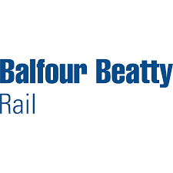
Coalition member organisations
Notes:
These issues are industry wide. In 2016 discussions began about what could be done to improve relationships and drive down conflict and disputes. This idea became an initiative through RICS and the Institute of Civil Engineers who realised the power of collaboration across the sector about how disputes are valued. The Conflict Avoidance Pledge was conceived by a Steering Group comprising of RICS, Institute of Civil Engineers, Chartered Institute of Arbitrators, Royal Institution of British Architects, International Chamber of Commerce, Institute of Civil Engineering Surveyors, Dispute Resolution Board Foundation, Urban Growth Company, Transport for London and Network Rail
The Pledge is a commitment to proactively avoid conflict and facilitate early resolution of emerging disputes. By signing up to the Pledge individuals, businesses and organisations vow to promote collaborative working and use early intervention techniques to try to avoid, manage and resolve differences of opinion more efficiently and before they intensify into formal disputes. There is no charge to sign up to the pledge firms can register at: www.rics.org/capledge
We still have and continue to have forms of ADR such as adjudication but they do not always cover the wider issues or get to grips with the crux of the problem. So a coalition was developed to bring these organisations together and their collective power enables influence within the sector to look at how managing disputes better can help the industry.

Slide 59
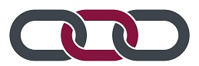
The Conflict Avoidance Pledge - commits signatories to:
Adopt early intervention techniques throughout the supply chain, to try to avoid, manage and/or resolve issues before they escalate into disputes
Embed conflict avoidance mechanisms into projects with the aim of identifying, controlling and managing potential conflict, whilst preventing the need for formal dispute resolution procedures
Identify potential disputes early and use conflict avoidance measures in practice
Work with the industry to identify, promote and use these mechanisms
Around 400 signatories to date- see who has signed: rics.org/capledge

Slide 60
The Conflict Avoidance Pledge
We commit to working proactively to avoid conflict and to facilitate early resolution of potential disputes.
We believe in collaborative working and the use of early intervention techniques to try to resolve differences of opinion before they escalate into disputes.
We recognise the importance of embedding conflict avoidance mechanisms into projects with the aim of identifying, controlling and managing potential conflict, whilst preventing the need for formal, adversarial dispute resolution procedures. We commit our resources to embedding these into our projects.
We commit to developing our capability in the early identification of potential disputes and in the use of conflict avoidance measures.
We will promote the value of collaborative working to prevent issues from developing into disputes.
We commit to work with our industry partners to identify, promote and utilise conflict avoidance mechanisms.
BATTLING THE HEADWINDS
A regional analysis of claims and disputes causation

Slide 61
Conflict Avoidance Directory
A published list of businesses and organisations committed to collaborative working and the use of early intervention techniques throughout the supply chain, to try to avoid, manage and resolve disputes collaboratively and without recourse, where possible, to adversarial procedures.
Bronze
Silver
Gold
Signed to the Pledge
Signed to the Pledge
Taken formal steps to incorporate policies to give effect to their commitment to avoiding and effectively managing disputes.
Signed to the Pledge
Taken formal steps to incorporate policies to give effect to their commitment to avoiding and effectively managing disputes.
Actively engaging in such policies

Slide 62
Government endorsement of conflict avoidance measures
The Construction Playbook 2022 outlines Government Guidance for sourcing and contracting public works projects in England and Wales.
It includes 14 key policies for assessing, procuring, and delivering public works projects.
Central government departments and arm's length bodies must adopt these policies on a 'comply or explain' basis.
Standard construction contracts such as NEC, JCT, and FAC-1 should be used for public works programs.
Contracts should include viable conflict avoidance and management measures.
Government departments and ALBs are encouraged to sign up to the conflict avoidance pledge (CAP).
They should demonstrate a commitment to conflict avoidance and use amicable resolution procedures for early dispute resolution.

Slide 63
Government endorsement continued…
UK Cabinet Office Guidance on responsible contractual behaviour
Welsh Government 12-point post covid recovery plan
Scottish Government Construction Policy Note (CPN) 2/2021
Real interest in Middle East and North America

Slide 64
Thank You.
Martin Burns RICS, Head of ADR Research and Development
www.rics.org/capledge

Slide 65
Introducing Her Honour Frances Kirkham CBE
Chartered Arbitrator, Adjudicator and Mediator and a past Judge of the Technology and Construction Court, England and Wales

Slide 66
Effective management of an international arbitration: is this possible?
Her Honour Frances Kirkham CBE

Slide 67
Speaker Panel Discussion

Slide 68
Thank you.
To view the recording of slides from today’s presentation, please visit https://www.ibqc.org.au/ibqc-forum-new/
For more information, please contact IBQC Executive Director Judy Zakreski at jzakreski@iccsafe.org

