Slide 1
IBQC Global Construction Dispute Resolution Conference
How to improve affordability and accessibility to construction dispute resolution – a global thought leadership conference
Session One, September 12, 2023, 8 a.m. GMT

Slide 2
Welcome & Housekeeping
This webinar will be recorded and will be posted on the IBQC website along with the presentation slides after the event.
Time permitting, we will address questions and discussion at the end of the presentations
If you have a question, please use the chat function at any time to submit your question.

Slide 3
Introducing the Hon. Justice Brian Preston, FRSN SC FAAL
Chief Judge of the Land and Environment Court of NSW Australia

Slide 4
Current challenges and opportunities for improvement of construction dispute resolution systems.
The Hon. Justice Brian Preston, FRSN SC FAAL
Chief Judge of the Land and Environment Court of NSW
IBQC Global Construction Dispute Resolution Conference
12 September 2023

Slide 5
The challenges
Construction disputes cost too much and take too long.
This cost and delay adds to parties’ stress associated with the dispute.
The cost, delay and stress can impede resolution of the dispute.
They can also impede access to justice - parties may feel that justice is out of reach.

Slide 6
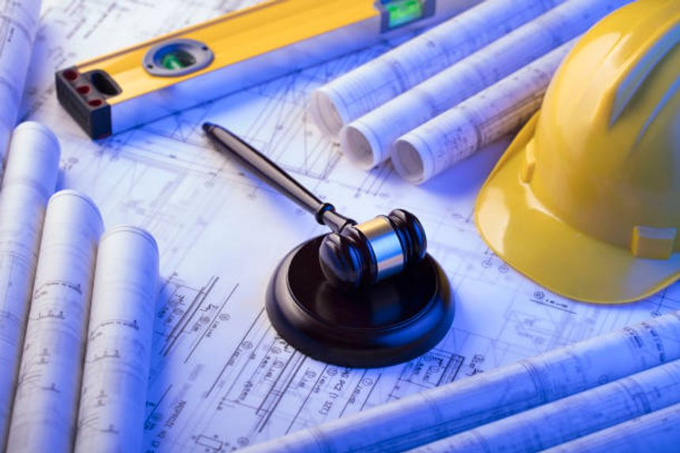
Components of construction dispute resolution system
There are three components of design of a construction dispute resolution system:
the dispute resolution institution
the dispute resolution mechanisms
the case management process

Slide 7
Institutional design
The institutional design of the construction dispute resolution institution is critical to ensuring access to justice.
Three components of the institutional design:
Constitution
Competence
Expertise

Slide 8
Constitution of institution
The constitution of the construction dispute resolution institution includes:
the types of institution, such as a court or tribunal
the positioning within the judicial hierarchy
the jurisdiction of the institution
the functions the institution is authorised to exercise.

Slide 9
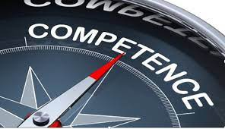
Competences of institution
The competences of the construction dispute resolution institution include:
constitutional competence
institutional competence
Constitutional competence refers to the proper role of the institution in the government and governance of the polity.
Institutional competence concerns the capacity of the institution to exercise its jurisdiction and functions:
this includes the dispute resolution mechanisms the institution can use to resolve construction disputes.

Slide 10
Expertises of institution
The expertises of the construction dispute resolution institution include:
contributory expertise
interactional expertise
Contributory expertise refers to legal expertise – the skills, knowledge and experience needed to contribute to the application and development of the law.
Contributory expertise in building and construction law is specialised legal expertise.

Slide 11
Expertises of institution
Interactional expertise refers to the need to interact with other disciplines of relevance to construction disputes, including building, engineering and architecture.
Interactional expertise assists the institution to understand and resolve the real issues involved in construction disputes.
The institutional design can incorporate both expertises by providing for two types of specialist decision-makers – lawyers and technical experts.

Slide 12
Dispute resolution mechanisms
Institutional competence includes the dispute resolution mechanisms the institution can use to resolve disputes.
The dispute resolution mechanisms include:
adjudicative (non-consensual) mechanism
consensual mechanisms such as mediation and conciliation
hybrid mechanism such as med-arb or arb-med.
Institutional expertise includes having members of the institution with expertise in the use of different dispute resolution mechanisms:
legal members for adjudication
technical members for conciliation and mediation.

Slide 13
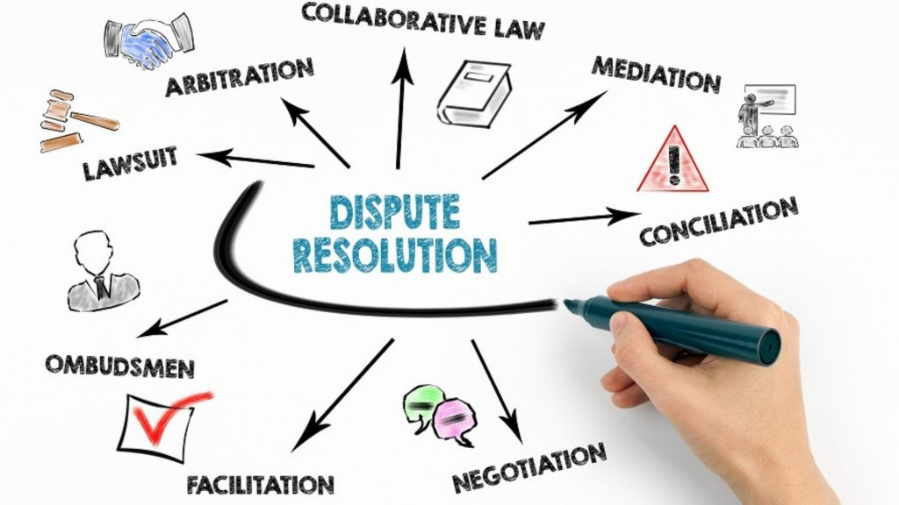
Appropriate dispute resolution
Appropriate dispute resolution involves matching the forum to the fuss:
forum: the dispute resolution mechanism
fuss: the individual dispute.

Slide 14
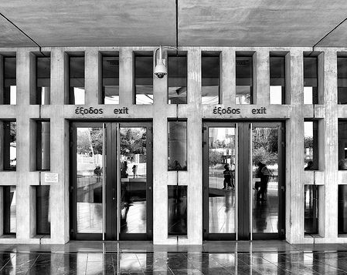
Multi-door courthouse
The institutional design can provide for a multi-door courthouse.
This is a dispute resolution centre offering a variety of dispute resolution mechanisms and matching the appropriate mechanism (the forum) to the individual dispute (the fuss).

Slide 15
The case management process
The institutional design should provide for case management of construction disputes from filing to finalisation.
The overriding purpose is to facilitate the just, quick and cheap resolution of the real issues involved in the dispute.
The case management process should be:
simple;
relevant and proportional; and
efficient and effective.
This involves differential case management – tailoring the case management directions to fit the individual dispute.

Slide 16
IBQC Good Practice Guidelines
The IBQC Good Practice Guidelines for the Development of Construction Dispute Resolution Tribunals and Decision-Making Institutions assist in the design of the dispute resolution institution, mechanisms and case management process to facilitate access to justice for all in construction disputes.

Slide 17
Introducing Adjunct Professor Kim Lovegrove MSE RML
Lovegrove & Cotton – Construction and Planning Lawyers Australia, Chair of the IBQC, past Senior Law Reform Consultant to the World Bank

Slide 18
Ways to Improve Efficiencies and Generate Cost Savings in Construction Dispute Resolution Theatres An IBQC Conference Some insights on ways by which construction dispute resolution systems can improve, derived from advice given on the writer’s various law reform deployments in Japan, Africa and China.

Slide 19
The Construction Index: Claims and Disputes Plague Projects
Claims advisory and dispute resolution experts HKA investigated claims and disputes on 1,602 projects in 100 countries for it’s 2022 annual Crux Insight report. The combined value of the projects investigated exceeds US$2 trillion (roughly £1.7 trillion).
Total claims analysed in the report exceeded US$80 billion in value, while the cumulative overruns add up to 840 years. [1]

Slide 20
Less than optimum construction dispute resolution systems:
Work against utilitarian outcomes for parties embroiled in legal proceedings
By and large destroy commercial relationships and contracting relationships per se
Lead to divergent rather than convergent outcomes
Therefore, in many respects, it is misleading to describe construction dispute resolution as ‘dispute resolution’; for dispute resolution in it’s purest form is more about resolving a conflict - resolving being the operative word, rather than the imposing of an outcome on the parties
Courts and Tribunals impose outcomes on parties
Mediation and ADR enable the parties to fashion and collectively design outcomes on the basis of a mutually of interests
Just because there is a dispute does not mean that there cannot be a meeting of the minds and an affable convergent outcome – an outcome where water is poured on the fire as it were rather than the infusion of benzine

Slide 21
Convergent dispute resolution
Negotiation and mediation works like water: it puts the fire out

Slide 22
Divergent dispute resolution
Can create an inferno as it repudiates any potential accord

Slide 23
Some best practice proposals
Mandatory front end and early-stage mediation
Dedicated construction dispute resolution divisions
Consolidation mechanisms that allow for joinder of all relevant parties to a single proceeding
Court or tribunal appointed highly qualified expert witnesses, venerated by peers of good repute

Slide 24
Mandatory front end and early-stage mediation support
In keeping with the philosophy of convergent dispute resolution, where the mantra is to put the fire out:
Mediation will be mandatory
Will occur shortly after legal proceedings are issued ie within 6 months or so
All key actors, responsible and affected parties will be required to attend the mediation
This allows the parties to better navigate an amicable solution by way of negotiation and the impartial guidance and cajoling of the mediator

Slide 25
Dedicated construction dispute resolution divisions
Best practice jurisdictions ensure that there exists within the courts or the tribunal, specialised lists dedicated to construction dispute resolution which concern themselves exclusively with that area of speciality.
Within those divisions, arbiters will practice either exclusively or predominately construction dispute resolution.

Slide 26
Consolidation mechanisms to better ensure joinder of relevant parties to a single proceeding
Best practice jurisdictions will have mechanisms that ensure that all implicated parties can be compelled to participate in a consolidated set of single proceedings

Slide 27
Court appointed, highly qualified expert witnesses
In this writer’s submission, and this is based upon personal experience, in the order of 30% of the cost and time involved towards construction dispute resolution can be attributed to the adversarial culture that in many jurisdictions that has become part of their DNA.

Slide 28
Best practice construction dispute resolution systems recognise and manage well expert witness testimony
There are those that are of the view that the role of the expert witness is even more important than the role of the legal advocate.
They would contend that as most building disputes are about building defects, cause of same, allocation of responsibility for defects and their cost of rectification, that the expert witness is indeed the paramount actor.
I tend to agree with those that prosecute this view

Slide 29
A best practice expert witness protocol will have an expert witness accreditation system
It is submitted that expert witnesses that wish to offer their professional wares, in a best practice jurisdiction will be:
Accredited by the apposite government department
Appointed to court or tribunal panels of expert witnesses
Required to complete annual professional development training to continue to hone their craft

Slide 30
How a court appointed witness system will operate
After the initiation of legal proceedings there will be a directions hearing where appropriate experts are appointed to:
Inspect
Diagnose
Cost
Prepare a report on point
Copy the report to disputants, court or tribunal member

Slide 31
The benefits of court appointed expert witnesses
Shorter trial length
Earlier settlement
A reduction in costs of the proceeding
A reigning in of expert witness ‘pugilism’ in that court appointed experts will remove the adversarial modus operandi

Slide 32
Conclusion
Best practice construction dispute resolution ecology will feature:
Mandatory front-end mediation
Dedicated building lists
An accreditation system which accredits expert witnesses
Courts/tribunal appointed expert witnesses
The renumeration of both mediators and the expert witnesses on the basis that the parties pay for their retention
If these elements are enshrined in construction dispute resolution apparatus, I predict that the costs of dispute resolution will dramatically reduce and will be conducive to a more holistic and utilitarian outcome that is in keeping with the philosophy of convergent dispute resolution.

Slide 33
References
[1] The Construction Index, ‘Claims and Disputes Plague Major Projects’ The Construction Index: The Construction Search Engine (Research Article, 28/10/2022) <https://www.theconstructionindex.co.uk/news/view/claims-and-disputes-plague-major-projects?utm_source=tci&utm_medium=sharing&utm_campaign=linkedin>.

Slide 34
Presented by Adj Professor Kim Lovegrove MSE, RML
Founder – Lovegrove and Cotton, construction and planning lawyers Australia
Chair of the IBQC, past Senior Law Reform Consultant to the World Bank
The views expressed in this paper are of the writer
only and are not the views of any other body.

Slide 35
Introducing Phillip Greenham
Enterprise Fellow Melbourne Law School, Senior construction lawyer and arbitrator Australia

Slide 36
Good Practice Guidelines Regarding Dispute Resolution Taming the wild world of construction disputation

Slide 37
The Need
Building disputes are problematic
Expensive
Time consuming
Commercial disputes
Undermine industry productivity and efficiency
Compromise the achievement of value for money
Residential disputes
Emotionally draining and damaging
Beyond the reach of many participants

Slide 38
The Philosophy
Suitable for all types of disputes and projects
Major and minor projects
Large and small disputes
Cross culture
Suitable for all countries on the development spectrum
Suitable for different legal landscapes
Therefore
Simplicity
Flexibility

Slide 39
The Principles
Principles 1 – The forum
Supporting Legislation
Generally open to the public
Principle 2 – Adequately resourced
Avoid delays
Appropriate qualifications

Slide 40
The Principles
Principle 3 – Respected members
Principle 4 – Cost
Cost should not be a barrier
Administrative costs
Process costs

Slide 41
The Principles
Principle 5 – Efficient processes
Pre issue
Initiation
Information exchange
Very limited discovery (civil law approach)
Case management
Evidence
Rules of evidence generally not to apply

Slide 42
The Principles
Principle 6 – Experts
Not advocates
Practice notes
Tribunal engagement vs party engagement
Flexibility
Joint reports

Slide 43
The Principles
Principle 7 – Appeals
Available
But very limited

Slide 44
The Principles
Principle 8 – Process
Administrative and case management
Efficient
Short time frames
Target 120 days from issue to conclusion
Active mediation
Opinion expressed

Slide 45
The Principles
Principle 9 – Early settlement encouraged
Short time frames
Early and active mediation
Trained personnel

Slide 46
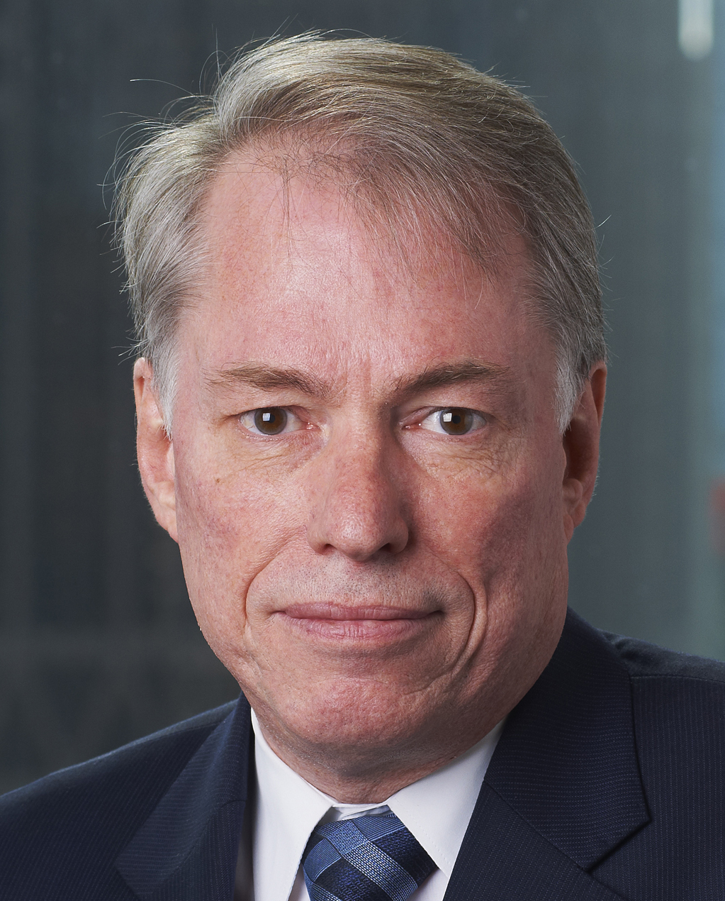
Presented by Phillip Greenham FCIArb
Enterprise Fellow, Melbourne Law School
Fellow, Chartered Institute of Arbitrators
Chair, Society of Construction Law Australia (former)
The views expressed in this paper are of the writer only and are not the views of any other body.

Slide 47
Introducing Gideon Westhuizen
Global Corporate, Compliance, Government and Risk Expert, specialising in indigenous and traditional affordable shelter and provision with Australian First Nations People and within African urban constructs

Slide 48
IBQC Global Construction Dispute Resolution Conference, 12 – 13 September 2023
The Quest for Culturally Appropriate Mediation in Developing Constructs – role of mandates in achieving effective dispute resolution
Gideon van der Westhuizen, Urban Planning Specialist

Slide 49
Mediation – focus ...
Define the mediation imperative- the mandate / instruction
Look into culturally appropriate mediation and how unconscious bias could be a barrier to achieving successful outcomes in effective dispute resolution

Slide 50
Mediation – role of the mandate ….
Mandate Legitimacy - every mediation needs to be based on a mandate that shapes the process and outcome sought.
Research globally confirms mandates are treated very seriously by mediating organisations and mediators, as it ought to.
Mandates serve several functions. They:
Confer legitimacy on a mediation;
Endow the mediator with authority and leverage;
Provide the mediator with instructions; and
Set the parameters of the dispute resolution process and outcome.
Example:
In African contexts for example, mediation mandates are typically contained in resolutions passed by the United Nations Security Council, the African Union’s (AU) Peace and Security Council or sub-regional bodies that attempt to resolve specific conflicts.

Slide 51
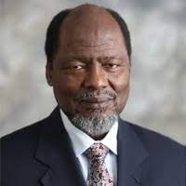
Mediation – the mandate …
A mandate is an instruction to the mediator. Mediators who deviate from their mandate risk being replaced.
Mandates have paradoxical effects. They limit a mediator’s flexibility and can greatly complicate the mediation. But they also give the mediator authority and leverage when trying to encourage cooperation between intransigent parties.
In addition to the mandate issued by the mediating organisation, the mediator must also seek a mandate from the conflict parties. This is essential because mediation is a cooperative effort that cannot take place meaningfully without the consent of the parties.
Case Study:
In a Madagascar case, SADC sidelined its mediator, former Mozambique President Joaquim Chissano, when he ignored the mandate by accepting that Ravalomanana could not return to Madagascar.

Slide 52
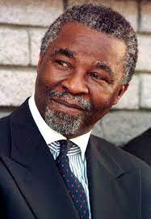
Mediation – the mandate (c’tnue) …
Parties can withhold consent in different ways. They can:
Reject mediation emphatically
Reject the mediating organisation
Call for the mediator to be replaced
Failure to obtain a strong mandate from the parties can weaken the mediator’s authority and credibility. It can also cause domestic and international stakeholders to lose confidence in the mediation and give rise to rival peacemaking bids.
Case Study:
The Movement for Democratic Change called for the Mediator to be changed during Mbeki’s mediation for Zimbabwe.

Slide 53
Mediation – cultural appropriate mediation …
Mediation outcomes can vary and differ in complexity due to cultural differences.
Different cultures have set values and beliefs.
When these come into play, mediators are challenged to draw on additional skills to assist parties reach a mediated outcome.
Cross-cultural situations can seem daunting for some and seen to be an advantage by others. This highlights the importance of being culturally sensitive. Legal rights present an added difficulty.
Example:
Significant cultural differences may alter the effectiveness of a mediated outcome.
Intercultural disputes, internationally or domestically, require a mediator to take cultural differences into consideration.
Mediation is primarily focused on effective communication with an eye to ensuring there are no legislative breaches. Communication methods differ globally, depending on the historical development, legal systems, ethnic and cultural backgrounds of each jurisdiction.

Slide 54
Mediation – cultural appropriate mediation
(c’tnue) …
When handling cultural aspects during mediation, mediators should be aware of their bias which is defined as a prejudice for or against something.
Implicit bias describes when we have attitudes towards people or associate stereotypes with them without our conscious knowledge.
Two of the most common problems identified in intercultural disputes are:
the communication barrier, and
culturally-driven interests.
Examples:
A commonplace example of this is seen in studies that show that we frequently associate criminality with indigenous people without even realising that we are doing it. Mediators are not exempt from this trap of implicit bias.
Reference SA and African examples where key mediators were stood aside / replaced due to perceived bias

Slide 55
Mediation – cultural appropriate mediation
(c’tnue) …
Language as a social instrument reflects a culture.
Examples:
The test of word association clearly shows that the meaning of words is culturally defined; whilst for basic concepts, such as food, associations across cultures are still rather similar, associated words may vary broadly for more complicated concepts.
As a matter of fact, some of the words may prompt positive associations in some cultures and negative ones in others. This is of crucial importance from the point of view of mediation since the outcome generally takes the form of a written agreement.
In addition, different attitudes to verbal and non-verbal communication are likely to complicate the communication process further: the direct, frank, and confrontational style prevalent in individualist, low-context societies can easily be misunderstood as rudeness and lack of respect by those from collectivist societies. What may be insignificant for some can be deplorable for others.

Slide 56
Mediation – cultural appropriate mediation
(c’tnue) …
Bias: are mediators able to detach themselves from their own cultural assumptions and values?
Around the world, people communicate their intentions not only through the words they speak, but through tones, gestures, and body language. These signals are often made and interpreted subconsciously.
Mediators may resort to interpreting parties’ motivations through the lens of their own culture rather than grappling and empathizing with the cultures of the parties. Alternatively, mediators may ignore rather than explore their values and assumptions.
Examples:
Interestingly for some Aboriginal cultural groups, interruptions are taken as a sign of disrespect and rudeness. A mutual expectation that each party will be able to speak without interruptions might need to be established in the introductory remarks of the mediator. Overt intervention may not always be appropriate.

Slide 57
Mediation – conclusion …
Mediation as a worldwide dispute resolution tool should motivate mediators to broaden their knowledge and improve their skills in cultures where “we both win” is critical.
It is crucial that a mediator is aware that culture will not be the same between disputants and consciously develop and improve their knowledge and skills to handle the process, under these circumstances.
If the mediator fails to consider cultural factors, where these are a crucial element of the whole, disputants may have a very poor experience of the mediation process.
Case Study:
The first Victorian Aboriginal Justice Agreement (AJA1 2000-2006) was developed in response to recommendations from the 1991 Royal Commission into Aboriginal Deaths in Custody and subsequent 1997 National Ministerial Summit on Indigenous Deaths in Custody.
Under the Aboriginal Justice Agreement’s Outcomes Framework, Goal 1.2 calls for Mediation capacity building. Specifically, a call is made to build capacity in mediation skills within ACCHOs and for community members to help resolve local disputes before they escalate.

Slide 58
Introducing Professor Robert Whittaker AM, FRSN
Past President Australian institute of Building, Vice Chair IBQC

Slide 59
Improvements in Core Duties of Expert Witnesses The case for improved expert witness rigour and accreditation protocols

Slide 60
Expert witnesses must have very robust qualification and experience-based credentials
Expert witnesses perform a critically important role in the resolution of building disputes
However, there is no uniform accreditation mechanism for the deployment of expert witnesses
This means there can be uncertain outcomes and variable results

Slide 61
The problem of adversarial expert evidence in conflict
There is a strong adversarial culture in construction dispute resolution
It is not unusual for a plaintiff’s expert witness to be too generous in terms of rectification cost assessment
Equally, it is not uncommon for a defendant expert witness to be too miserly with regards to rectification cost
The net effect is a considerable disparity of evidence, which leads to protracted and very costly litigation

Slide 62
Recommendations that are aimed at improving expert witness deployment and expert witness rigour
The development of an accreditation regime to ensure that the very best expertise available can be used in construction dispute resolution
A panel of court or tribunal appointed experts

Slide 63
The single expert witness
The proposed system of a single expert witness would involve:
1. Legal proceedings are issued
2. The court or tribunal will convene a directions hearing
3. An expert witness will be appointed by the tribunal
4. The expert witness will be renumerated on a 50/50 basis by the disputants
5. The expert witness will inspect and prepare a report in terms of diagnostics and costings
6. The expert witness will also identity those responsible for defects
7. The report will be made available for both parties and the tribunal member
8. The report will also be made available to any mediator that is charged with the responsibility of trying to get the matter settled

Slide 64
The benefits of such an approach
The impartiality that will be part and parcel of a court appointed expert will be better conducive to:
Early settlement
Shorter trail length
Huge cost savings
Better outcomes for all disputants
In light of the fact that the expert witnesses will be jointly retained, the costs associated with expert witness advocacy will be dramatically slashed.

Slide 65
Conclusion
• There is hope and I am totally confident that if the above recommendations are adopted the cost of dispute resolution can be dramatically reduced, as well as seeing reductions in trail lengths

Slide 66
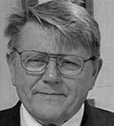
Presented by Professor Bob Whittaker AM, FRSN
Past National President Australian Institute of Building
Vice Chair, International Building Quality Centre
The views expressed in this paper are of the writer
only and are not the views of any other body.

Slide 67
Introducing Dr. Richard Manly
Preeminent construction law Barrister and Arbitrator, Australia

Slide 68
How to Fast-track Construction Dispute Resolution Best practice interlocutory logistics to fast track the dispute resolution journey.

Slide 69
Background
One of the general duties or paramount objectives that an arbitral tribunal or judge should observe at all times is to adopt procedures suitable to the circumstances of the dispute, avoiding unnecessary delay or expense, so as to provide a fair and efficient means for the final resolution of the dispute in question

Slide 70
Innovative Procedural Measures
Scott schedules
Redfern schedules
Reed retreat
Sachs protocol
Kaplan opening

Slide 71
Scott Schedule Typical Example
1 No of Item | 2 Full particulars of each item of work alleged to have been improperly or unskilfully performed, stating the defects complained of | 3 Plaintiff’s estimate of the cost of remedying the defects complained of, and, where the remedial work has been done, the cost thereof, identifying the relevant documents | 4 Defendant’s estimate of the cost of remedying any admitted defects | 5 Defendant’s observations | 6 Column for Official Referee
1 | DRAWING ROOM The paintwork on all wooden surfaces is peeling off, owing to insufficient preparation of the surfaces. Only one coat of paint was applied, instead of two as specified. It will be necessary to strip off the paint and repaint with two coats | $1,000.00 | (Either: Nil Or: $40,.00) | (Either: The work of preparation was properly done. The defects complained of have been occasioned by hard wear in the two years which have elapsed since the work was done. Or: It is admitted that a small area of paintwork in the NE corner of the room requires repainting).

Slide 72
Scott Schedule Benefits
Increase the possibility of settlement
Identification and clarity of areas of argument
Allow identification of differences
Assist in avoiding confusion at hearing
One convenient document which sets out competing claims

Slide 73
Example Claimant’s Redfern Schedule
Document requested | Relevance and materiality of the documents requested to the outcome of the dispute | Responses and objections to the claimant’s request to produce documents | Decision of the arbitral tribunal
Any and all documents (including documents in electronic form) consisting of information on the general structure of management and the decision-making processes of the respondent, including minutes of board meetings, shareholders’ meetings, and other documentation related to the decision-making process at the top level | The claimant asserts that the way in which the management processes were organised at respondent were inadequate and/or were the cause of the delays to production and the generally poor quality of the product. To prove these assertions, the claimant needs to know the respondent’s management structure and needs documents normally produced for the purposes of a company’s management at the level of top management (i.e. boards, shareholders’ meetings, etc.) | This request is so wide that an order for their production would impose an unreasonable burden on the respondent: see the IBA Rules on the Taking of Evidence, Art. 9.
A record of all previous complaints from customers since production began | Such documents will allow the claimant to establish the management methodology adopted by the respondent, and to demonstrate that this methodology was inadequate and unprofessional. | This request is too wide. However, the respondent is prepared to produce a list of complaints received over the last 18 months, whilst keeping the names of the customers confidential.
All correspondence and other documents with the respondent’s legal advisers concerning complaints by other customers | Such correspondence will demonstrate the steps to which the respondent went to deny liability for obvious deficiencies in the product. | To the extent that any such correspondence exists (which is denied), it would be covered by legal professional privilege.

Slide 74
Reed Retreat
The Reed Retreat is a conference of arbitral tribunal members where there is for example a panel of three members
The aim is to stimulate the members of the tribunal to familiarise themselves with the documents so they can engage with the other tribunal members in a meaningful dialogue

Slide 75
Sachs Protocol
The aim of the Sach’s Protocol is to assist the tribunal in its dealings with experts.
After the parties have submitted their first briefs, the tribunal invites both parties to provide the tribunal and the opposing party with a list of three to five persons they consider to be fit to serve as an expert for the determination of a particular question.
In a second step, the tribunal will choose two experts, one from each of the two lists, and appoint these experts together as an “expert team”.

Slide 76
Kaplan Opening
Intended to be a hearing before the tribunal after the first round of written submissions and witness statements have been delivered but prior to the main hearing
The main advantage of this process is that it adds convenience and efficiency to the tribunal’s decision making
The tribunal gets a better understanding of the case sooner, which facilitates its preparation for the ultimate hearing

Slide 77
Further Processes
treatment of Preliminary Issues;
proceeding by an Agreed Statements of Facts,
proceeding by an Agreed List of Questions or Issues; and
limited time / Stop clock hearing

Slide 78
Conclusion
As a general proposition, all litigants want results faster and cheaper
Rather than litigating, litigants more often than not just want a resolution of their dispute
Resolving disputes efficiently is not necessarily achieved by proceeding fast and doing things cheaply. What needs to be considered are the concepts of time, cost and quality

Slide 79
References
[1] Dr Klaus Sachs “Experts: Neutrals or Advocates” (2010) ICCA Congress, Conference Paper 13

Slide 80
Presented by Dr Richard Manly KC
Chancery Chambers, Melbourne
Preeminent construction law Barrister and Arbitrator, Australia
The views expressed in this paper are of the writer
only and are not the views of any other body.

Slide 81
Introducing Her Honour Judge Sharon Burchell
County Court judge in the Australian State of Victoria
A Video Presentation

Slide 82
Introducing Mark Colthart FCIArb
Senior Barrister and Arbitrator New Zealand

Slide 83
The Necessity for Stronger Institutions The need for specialist construction dispute resolution tribunals.

Slide 84
Introducing Justin Cotton
Director of Lovegrove & Cotton – Construction and Planning Lawyers Australia, and Chair of Housing Industry Association, Industrial Relations and Contracts Committee Victoria.

Slide 85
Why did Arbitration Lose its Relevance in Residential Dispute Resolution in Australia? An IBQC Conference

Slide 86
Background
Arbitration was effectively made illegal in the Australian State of Victoria following the enactment of Domestic Builders Contracts Act 1995
Prior to this, nearly all residential building contracts had arbitration clauses, which dictated that any dispute had to go to arbitration
section 14, of the said Domestic Builders Contract Act:
Arbitration clauses prohibited
Any term in a domestic building contract or other agreement that requires a dispute under the contract to be referred to arbitration is void.

Slide 87
The concerns that led to the demise of arbitration
The cost of arbitration
Lack of joinder power
Perception on the part of some certain consumer lobby groups of a lack of neutrality with some of the decisions

Slide 88
The promulgation of the Domestic Building Contracts Act 1995
Establishment of the dedicated building list for the resolution of building disputes in the Victorian Civil and Administrative Tribunal (VCAT)
Similar legislation in New South Wales by virtue of the promulgation of the Home Building Act 1989, and the similar administration of the New South Wales Civil and Administrative Tribunal (NCAT)

Slide 89
Conclusion
Commercial and civil disputes are dealt with primarily in a tribunal/court, although arbitration still maintains a role in some commercial and civil construction disputes.
Mediation is mandatory in VCAT, and typically occurs within 6 moths of the initiation of legal proceedings. This system is likely to remain in perpetuity.

Slide 90
Presented by Justin Cotton
Director of Lovegrove and Cotton, Construction and Planning Lawyer
Chairperson of the HIA Industrial Relations and Legal Services Committee
21 years experience in the resolution of construction law disputes
The views expressed in this paper are of the writer
only and are not the views of any other body.

Slide 91
Speaker Panel Discussion

Slide 92
Thank you.
Please join us for Session 2, September 13, 5 p.m. GMT. To register visit: https://www.iccsafe.org/dispute-resolution
To view the recording of slides from today’s presentation, please visit https://www.ibqc.org.au/ibqc-forum-new/
For more information, please contact IBQC Executive Director Judy Zakreski at jzakreski@iccsafe.org

